Slide 1
INDOOR POSITIONING SYSTEM USING DEEP LEARNING
Clyde Noronha
Mustafa Zaki
Shane Gracias
Ruman Mulla

Slide 2
Objective
The objective of this project is to provide the accurate, real-time indoor location of a user using deep learning, with the help of the accelerometer and gyroscope sensors available in smartphones.

Slide 3
Introduction
Global Positioning Systems (GPS) are limited to an accuracy of up to 5m, hence are not helpful indoors.
Indoor Positioning Systems (IPS) are a solution to locate oneself indoors.
Several approaches such as WLAN, Bluetooth, Geomagnetic Fingerprinting and Inertial Sensors.
Our approach is based on inertial sensors present in smartphones, using deep learning to improve the accuracy.
It is purely software based, and requires the user to just download an application and use it.
Significant applications include personal indoor navigation, healthcare monitoring and security.

Slide 4
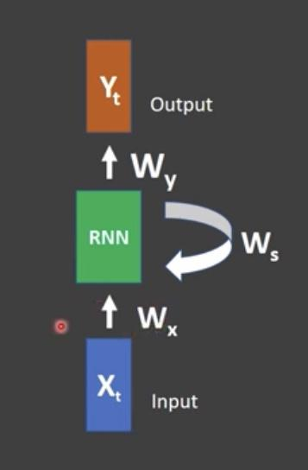
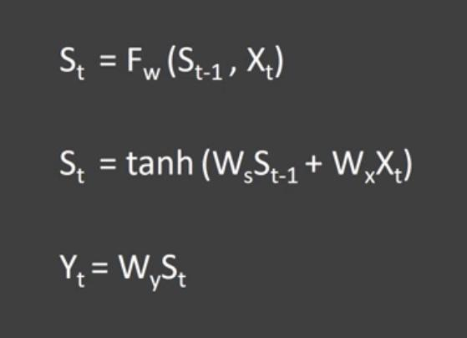
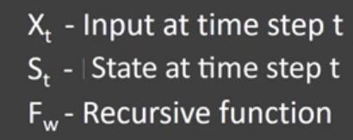
Recurrent Neural Networks
Recurrent Neural Networks are a type of neural network designed for capturing information from sequence / time series data. The output of the previous RNN is given as the input to the next RNN along with the main input.

Slide 5
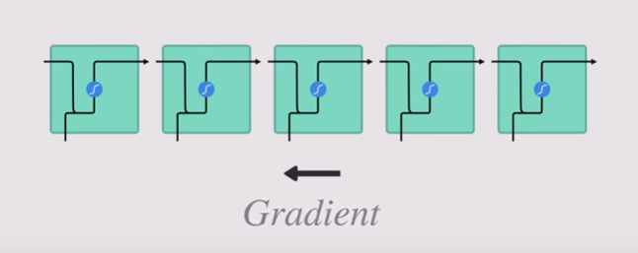
Limitations of RNN
Vanishing Gradient Problem
Gradient
During back propagation, gradient for each node is calculated using gradient for previous layer.
Therefore if the gradient in the previous layer is small, the gradient in the current layer ll be even smaller.
New Weight = Weight - Learning Rate * Gradient
2.0999 = 2.1 - 0.001
The weights are barely adjusted in the earlier layers causing it not to learn.

Slide 6
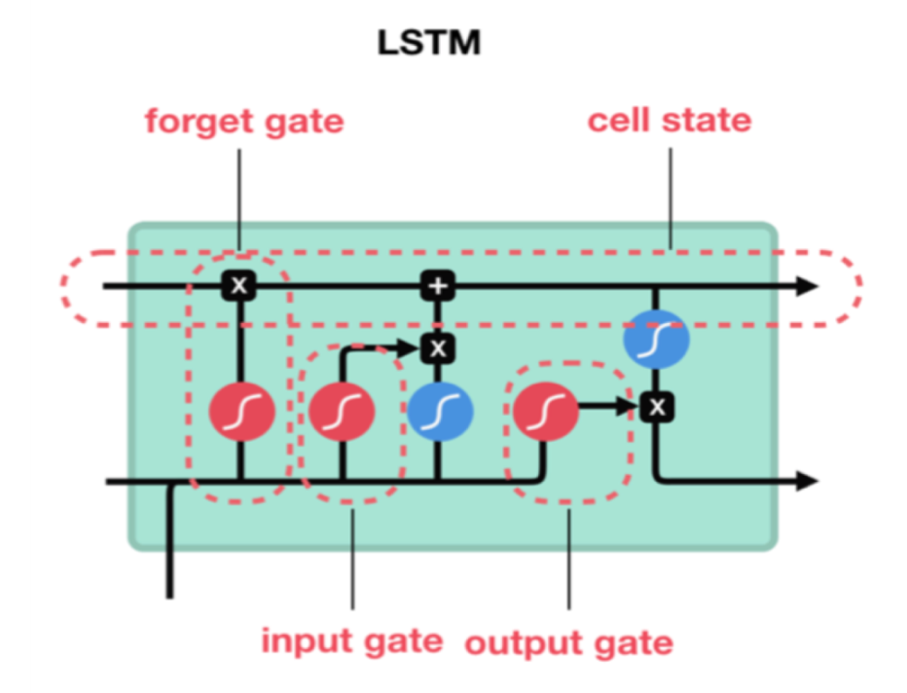
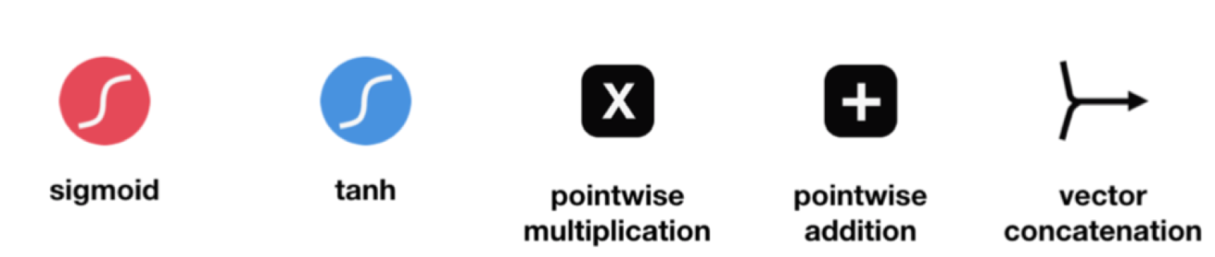
Long Short Term Memory (LSTM)

Slide 7
PROPOSED WORK & IMPLEMENTATION

Slide 8
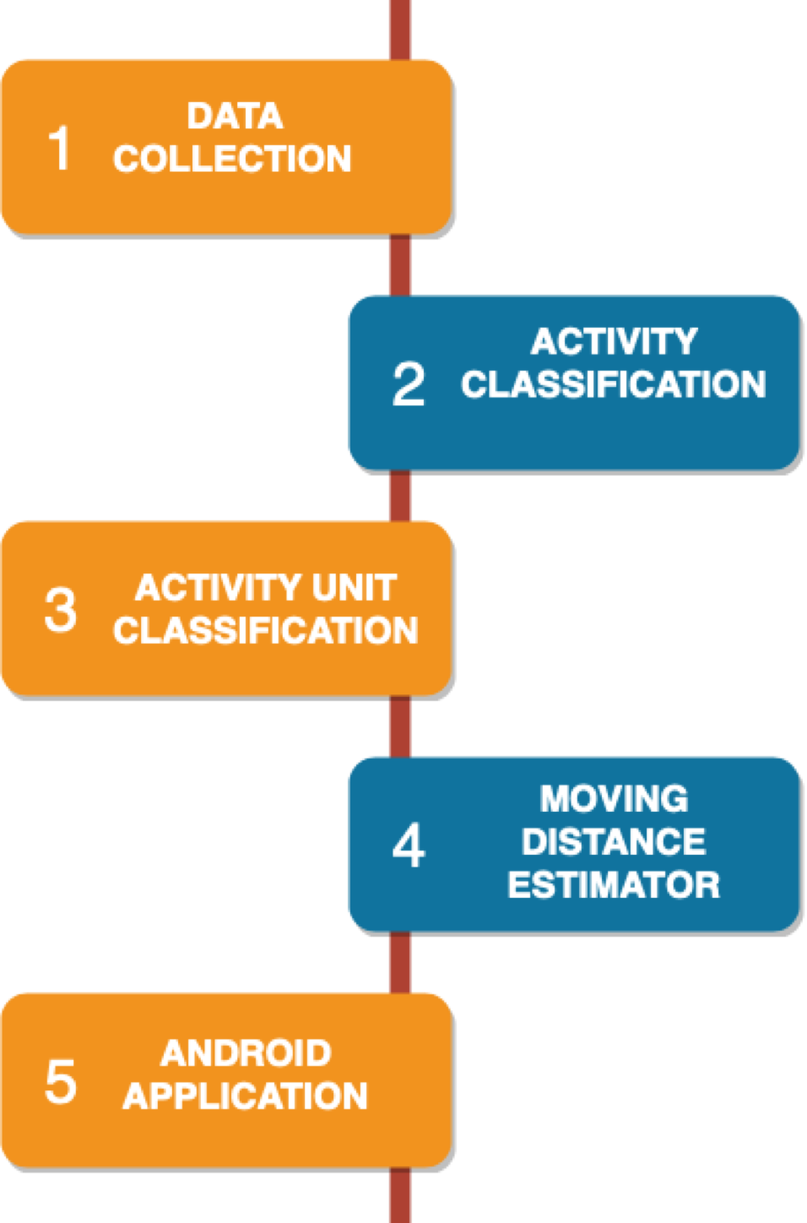
Level 0 Design Flow Diagram.

Slide 9
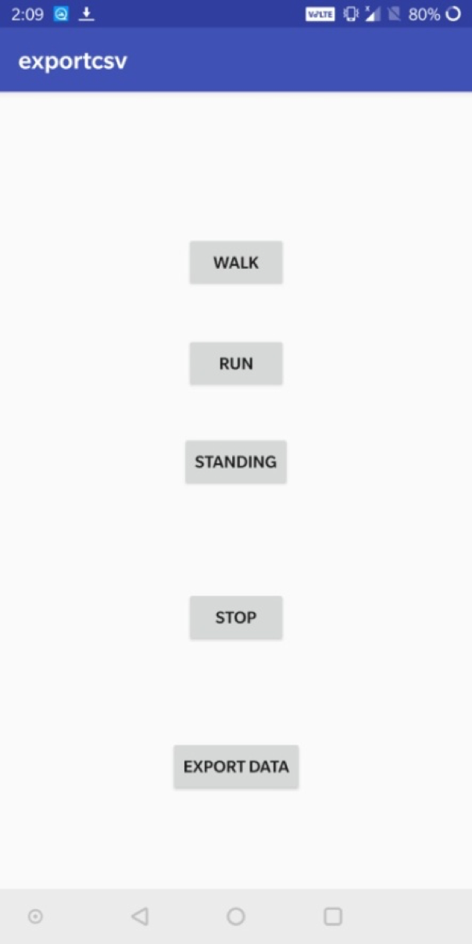
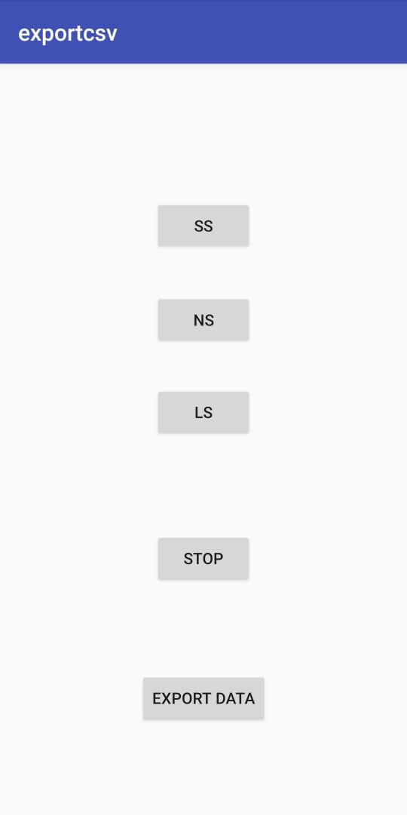
Data Collection
We built a simple app using Android Studio to collect accelerometer and gyroscope sensor data and store it in a .csv file.
Three buttons are provided to collect the data according to the activity or activity unit being performed. The data is recorded with a frequency of 50Hz. Once the data is recorded, we export it to a file.

Slide 10
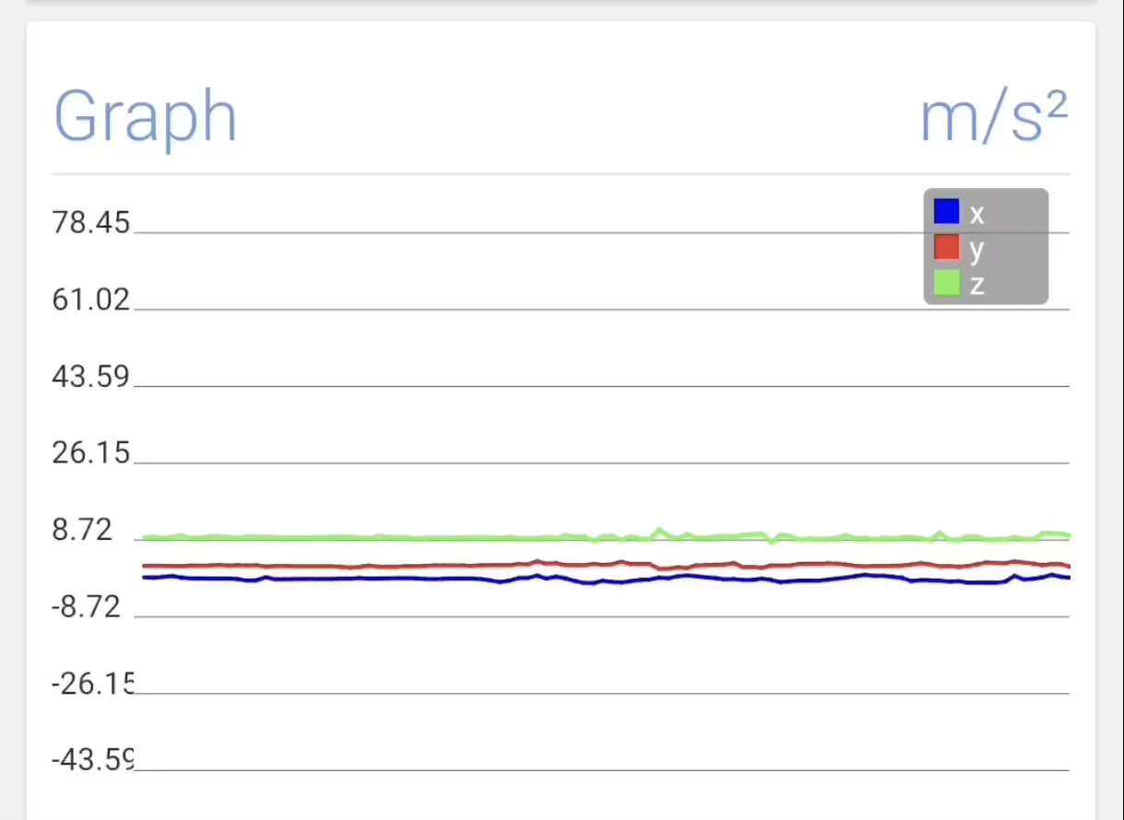
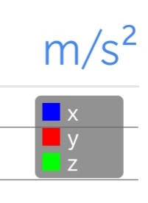
Collection of Accelerometer Data for Walking and Running

Slide 11
Activity Data
Previously, we had used the dataset obtained from Wireless Sensor Data Mining (WISDM) Lab containing 1,098,207 records.
However, it was discarded as it was incapable of accurately classifying data for our use case.
Hence, we collected our own activity data for the Activity Classification LSTM using the Data Collection app.

Slide 12
Activity Data
Label | Speed Setting
Standing | 0
Walking | 3
Running | 5.6
Data was collected on a treadmill with following speed setting corresponding to each label.
Label | No. of Records
Standing | 75,903
Walking | 90,584
Running | 57,903
The final dataset contained 2,24,390 records of the following labels.

Slide 13
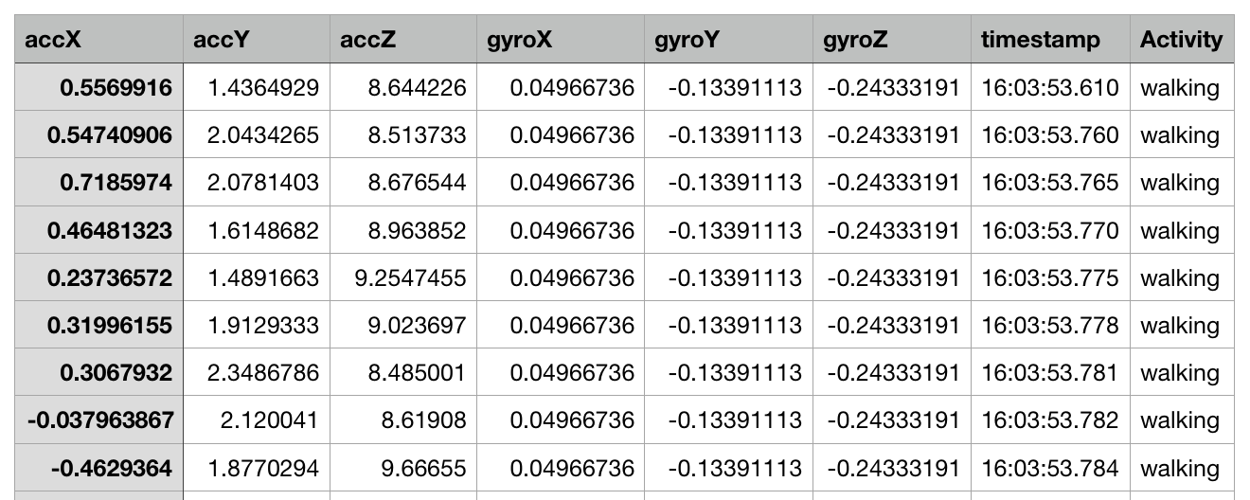
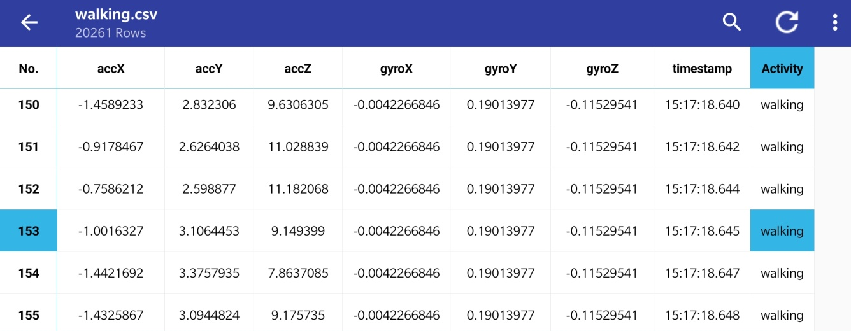
Activity Data

Slide 14
Activity Unit Data
We also collected our own data for the Activity Unit LSTM using the Data Collection app.
Label | Step Length (cm)
Short Step (SS) | 42
Normal Step (NS) | 75
Long Step (LS) | 92
Data was collected along a straight footpath with the following average step length corresponding to each label.
Label | No. of Records
Short Step (SS) | 76,917
Normal Step (NS) | 64,210
Long Step (LS) | 90,412
The final dataset contained 2,31,544 records.

Slide 15
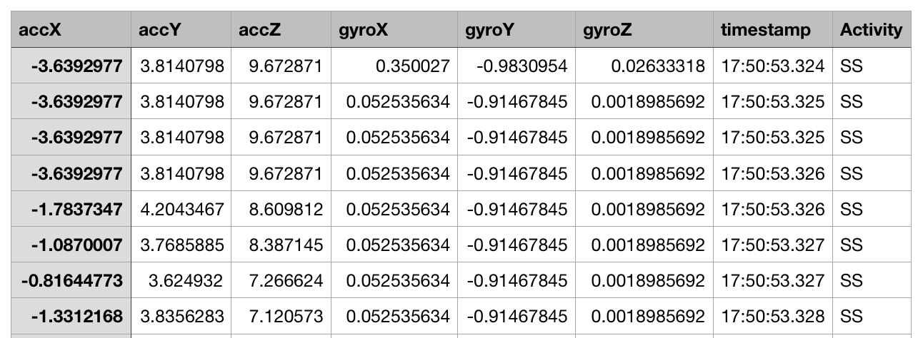
Activity Unit Data

Slide 16
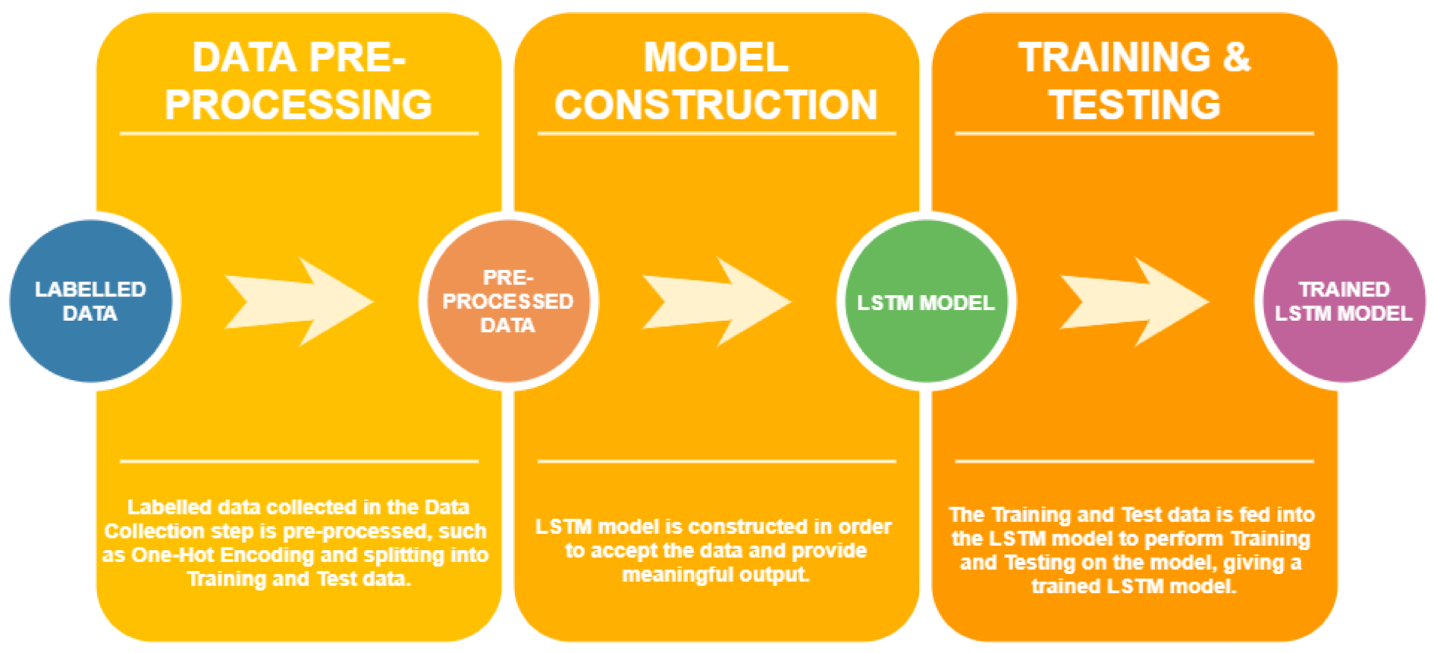
Activity Classification
The Activity Classification phase classifies the activities being performed by the user (Walking, Running, Standing) using an LSTM.
We have collected 2,23,816 records of data, and we use 3 features (accelerometer X, Y and Z) in order to build the model to output class labels as Walking, Running or Standing. There are 3 steps involved: 1. Data Pre-processing 2. Model Construction 3. Model Training & Testing
In addition, we created an android app to test the model.
Level 1 LSTM Design Flow Diagram

Slide 17
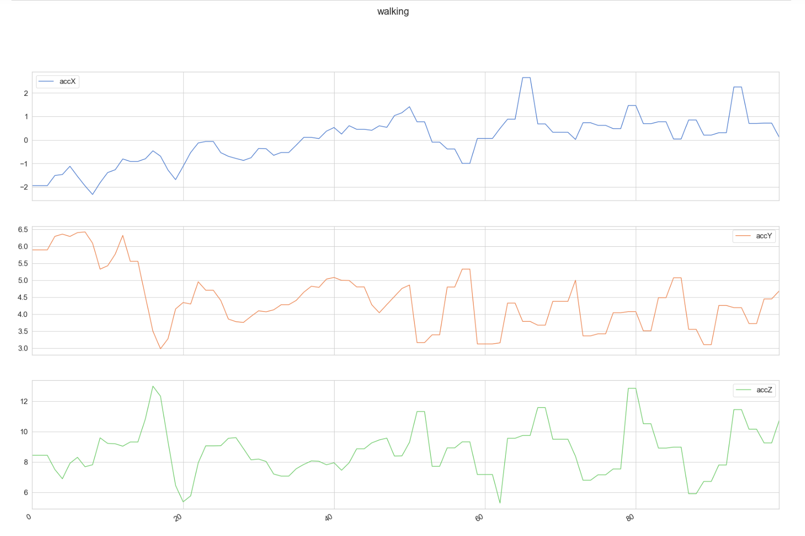
The number of training records for each type of activity were:
Standing – 75,903
Walking – 90,584
Running – 57,903
Sample Accelerometer Data for Walking

Slide 18
Activation Function – Softmax
Optimizer – Adam Optimizer
1. Data Pre-processing The data is transformed to include only the accelerometer x-axis, y-axis and z-axis data i.e. 3 features.
One-Hot Encoding is performed.
The data is split into training (80%) and test (20%) data.
2. Model Construction The LSTM model contains 2 LSTM layers stacked on top of each other with 64 hidden units each. Activation Function – Softmax.
The parameters used are as follows:
No of Features | No of Classes | Shape of Input | Shape of Output
3 | 3 | {1, 200, 3} | {3}
No of Samples | Learning Rate | No of Epochs | Batch Size
200 | 0.0025 | 40 | 1024

Slide 19
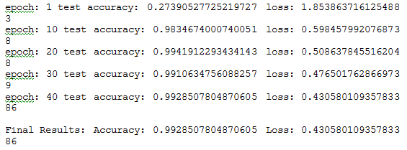
3. Model Training & Testing
40 epochs with batch size of 1024.
The output is the train and test loss and accuracy.
A working model is created, which can be exported and used further.
Final Accuracy – 99.3%
OUTPUT

Slide 20
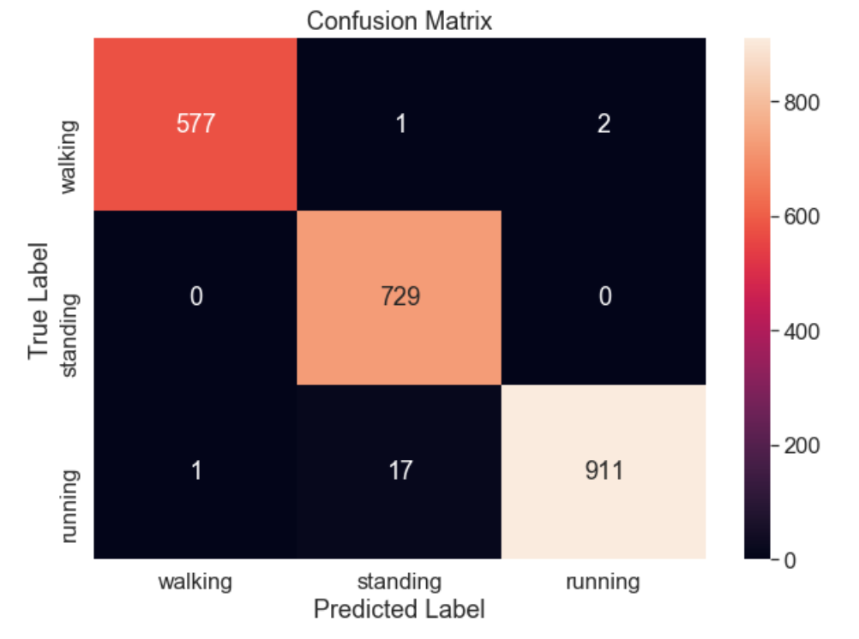
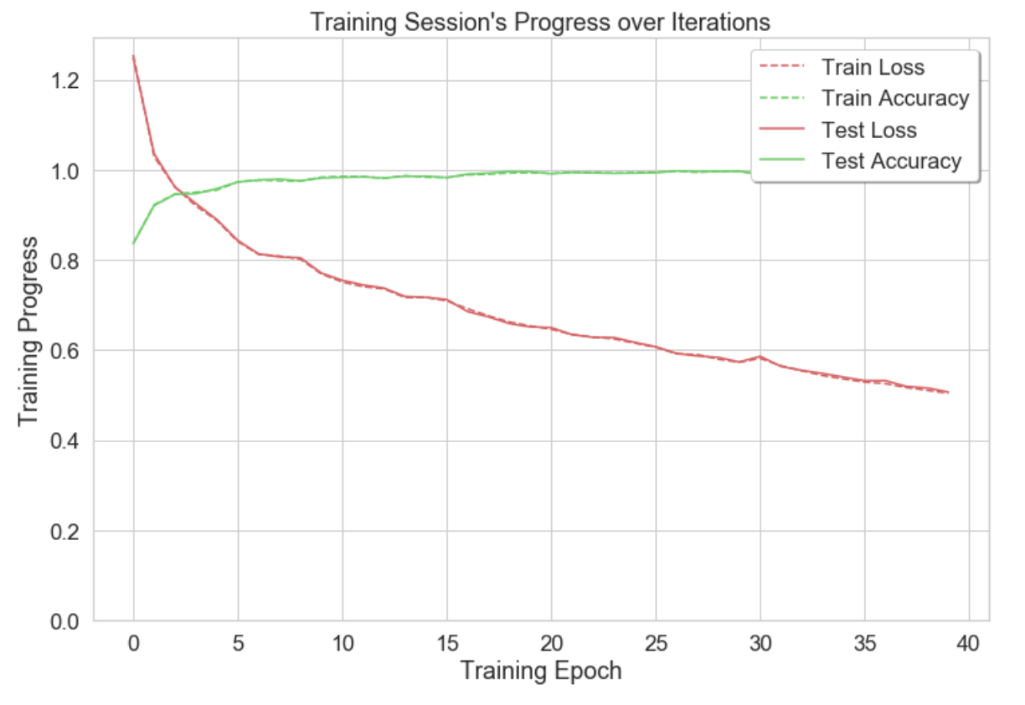

Slide 21
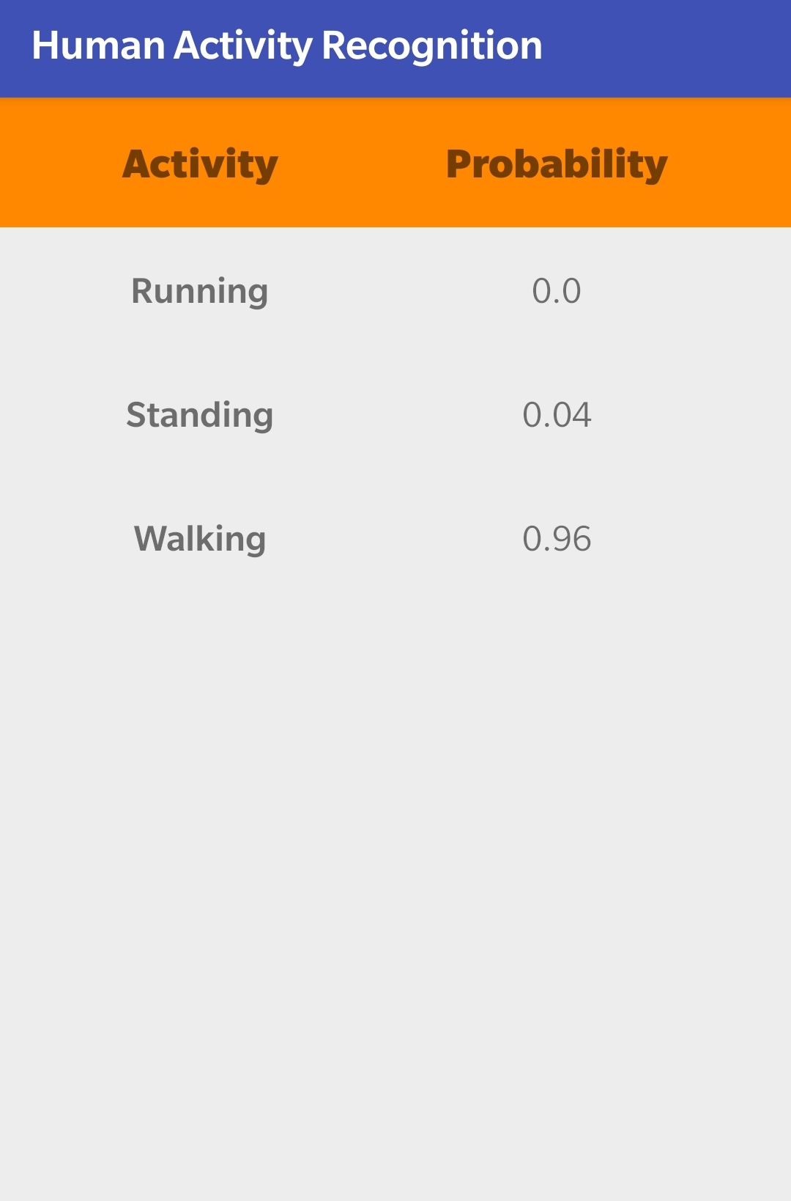
4. Android App for Testing
Basic android app that interfaces with the LSTM model to check if the predictions of the model are accurate.
Consists of a table with the class labels with the corresponding probability that it is occurring.
Activity with the highest probability is voiced out loud using text to speech.

Slide 22
Activity Unit (AU) Classification
The Activity Unit Classification phase classifies the activity units being performed by the user (Long Step, Normal Step, Short Step) using an LSTM similar to the previous module.
The purpose of this is to give a tighter real-time accuracy above the one already provided by the first LSTM.
The dataset contains 1,93,796 records of accelerometer X, Y and Z data, of the labels Long Step (LS), Normal Step (NS) and Short Step (SS).
The data was collected at a frequency of 50Hz, or 50 samples per second.

Slide 23
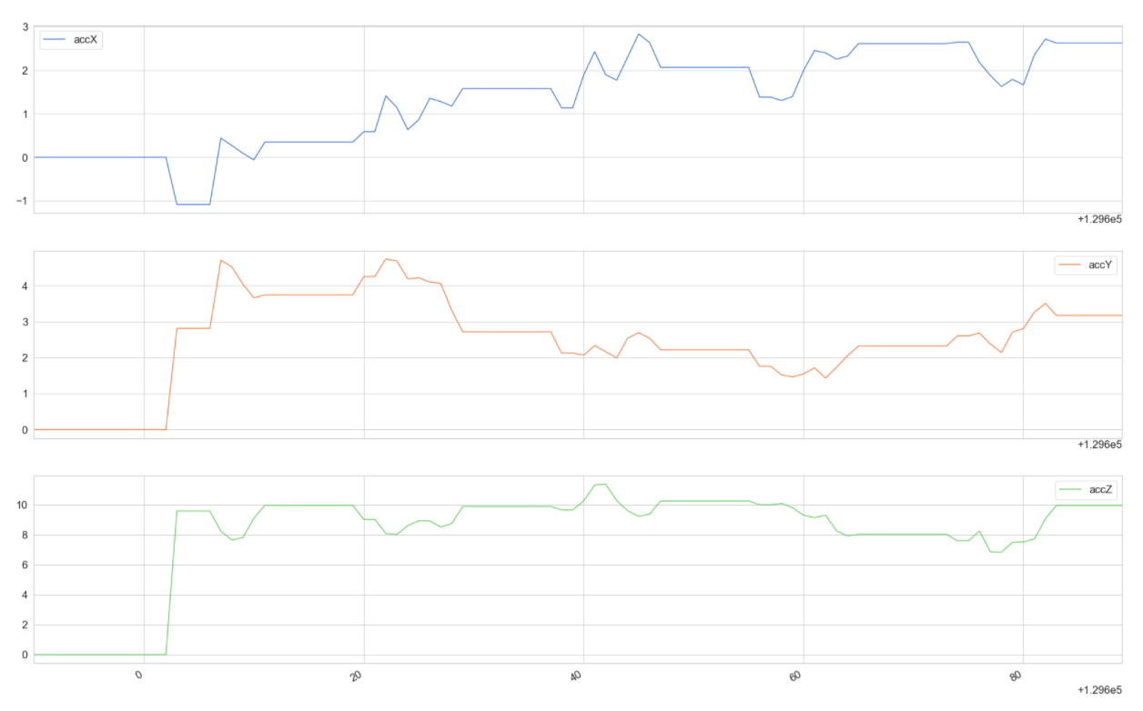
The number of training records for each type of activity were:
LS – 64,879
SS – 64,711
NS – 64,206
Sample Accelerometer Data for NS

Slide 24
Activation Function – Softmax
Optimizer – Adam Optimizer
1. Data Pre-processing The data is transformed to include only the accelerometer x-axis, y-axis and z-axis data i.e. 3 features.
One-Hot Encoding is performed.
The data is split into training (80%) and test (20%) data.
2. Model Construction The LSTM model contains 2 LSTM layers stacked on top of each other with 64 hidden units each. Activation Function – Softmax.

Slide 25
Activation Function – Softmax
Optimizer – Adam Optimizer
3. Hyperparameter Testing
Key parameters contributing to the accuracy – Batch Size, Learning Rate and No. of Samples.
Test #1 : No. of Samples = 100 and varying the other two.
Resulted in the upper limit of accuracy (95%) and optimal range of Batch Size & Learning Rate.
Test #2 : No. of Samples = 200, which improved the upper limit to 97% and gave optimal values for Batch Size & Learning Rate.
Test #3 : No. of Samples = 300, not useful due to inconsistencies.
The optimal parameters found were:
No of Features | No of Classes | Shape of Input | Shape of Output
3 | 3 | {1, 200, 3} | {3}
No of Samples | Learning Rate | No of Epochs | Batch Size
200 | 0.004 | 40 | 140

Slide 26
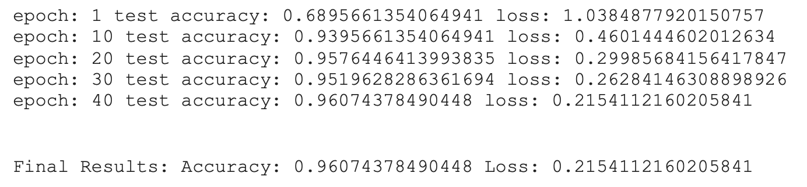
4. Model Training & Testing
40 epochs with batch size of 140.
The output is the train and test loss and accuracy.
A working model is created, which can be exported and used further.
Final Accuracy – 96.1%
OUTPUT

Slide 27
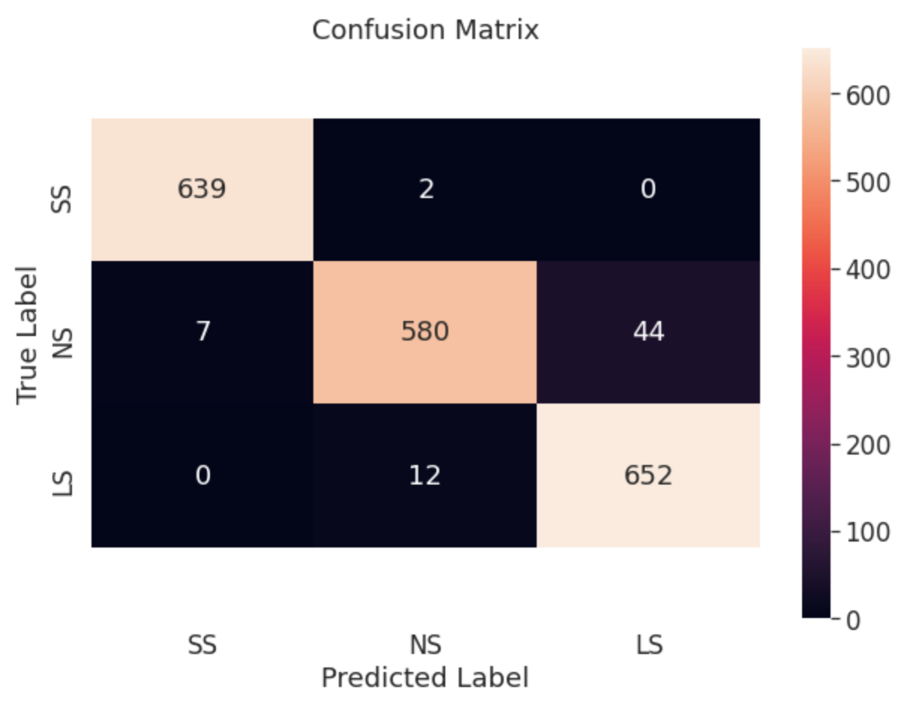
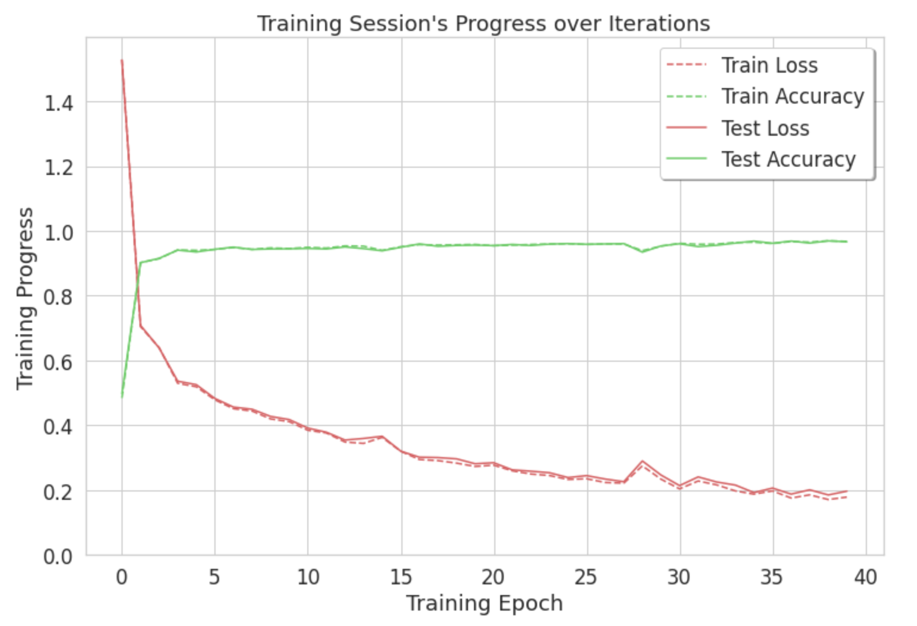

Slide 28
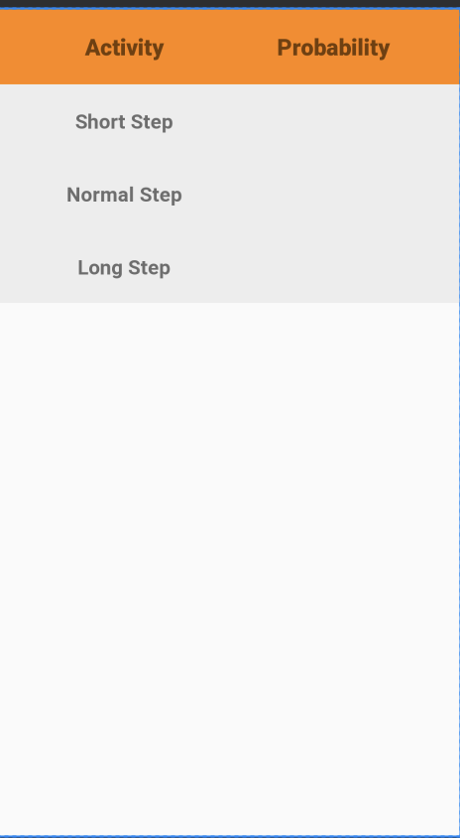
5. Android App for Testing
We built an android application with a simple user interface and exported the saved model to the app to check if it predicts the type of user step accurately with minimum delay.

Slide 29
Moving Distance Estimator
Works on principle that “a person will walk along a path with a consistent step type, unless an obstacle occurs.”
Output of the LSTMs fed into the Moving Distance Estimator.
Estimator has a buffer of a particular size, initially empty. It stores the step types.
Mode is calculated over the buffer.
Step type is converted to an actual step length value in pixels. (SS = 16px, NS = 18px, LS = 20px)
The step length is the output and is given as input for the movement of the Blue Dot in the final Android app.
Notes:
This ensures that if the LSTM provides a single reading that is different from the other readings in the buffer, it will not consider it. The Estimator will only consider a reading if it occurs consistently.

Slide 30
Android Application
Building the android application is the final module.
It consists of a basic floor plan of a room whose dimensions were mapped to the real world dimensions of the room.
The user has to select his/her initial position on the floor plan which is indicated by a Blue Dot and the user’s position and direction is traced as the person starts moving based on the outputs of the first and second LSTMs and the Moving Distance Estimator.
It has 2 parts, with several sub-parts:
Back-end : importing .pb files, connecting both LSTMs and connecting the distance estimator.
Front-end : Blue Dot, mapping coordinates, computing device orientation, updating device position, navigation, the node map, search bar and shortest path algorithm.

Slide 31
Back-end
The two LSTMs, after being created, were exported as protocol buffer (.pb) files and used as assets for the Android Application.
The application reads the probability outputs of these LSTMs and classifies the Activity and Action Unit accordingly.
This is then sent to another program in the application known as the Moving Distance Estimator which outputs a specific Step Length, and this is used in order to update the Blue Dot on the user’s screen.

Slide 32
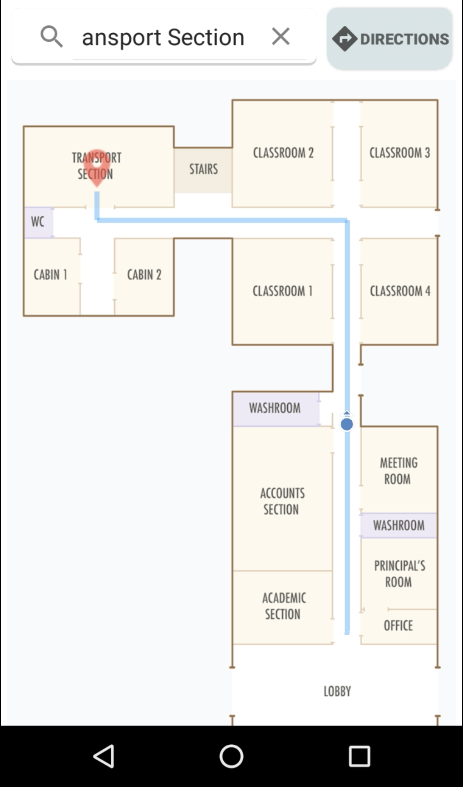
Front-end
The frontend of the application consists of a basic floor plan image to which the room’s dimensions have been mapped.
It also consists of a Blue Dot, which can be freely placed anywhere on the map in order to designate the starting position.
The user is able to search for their destination, and the shortest path is drawn from their position to the destination.

Slide 33
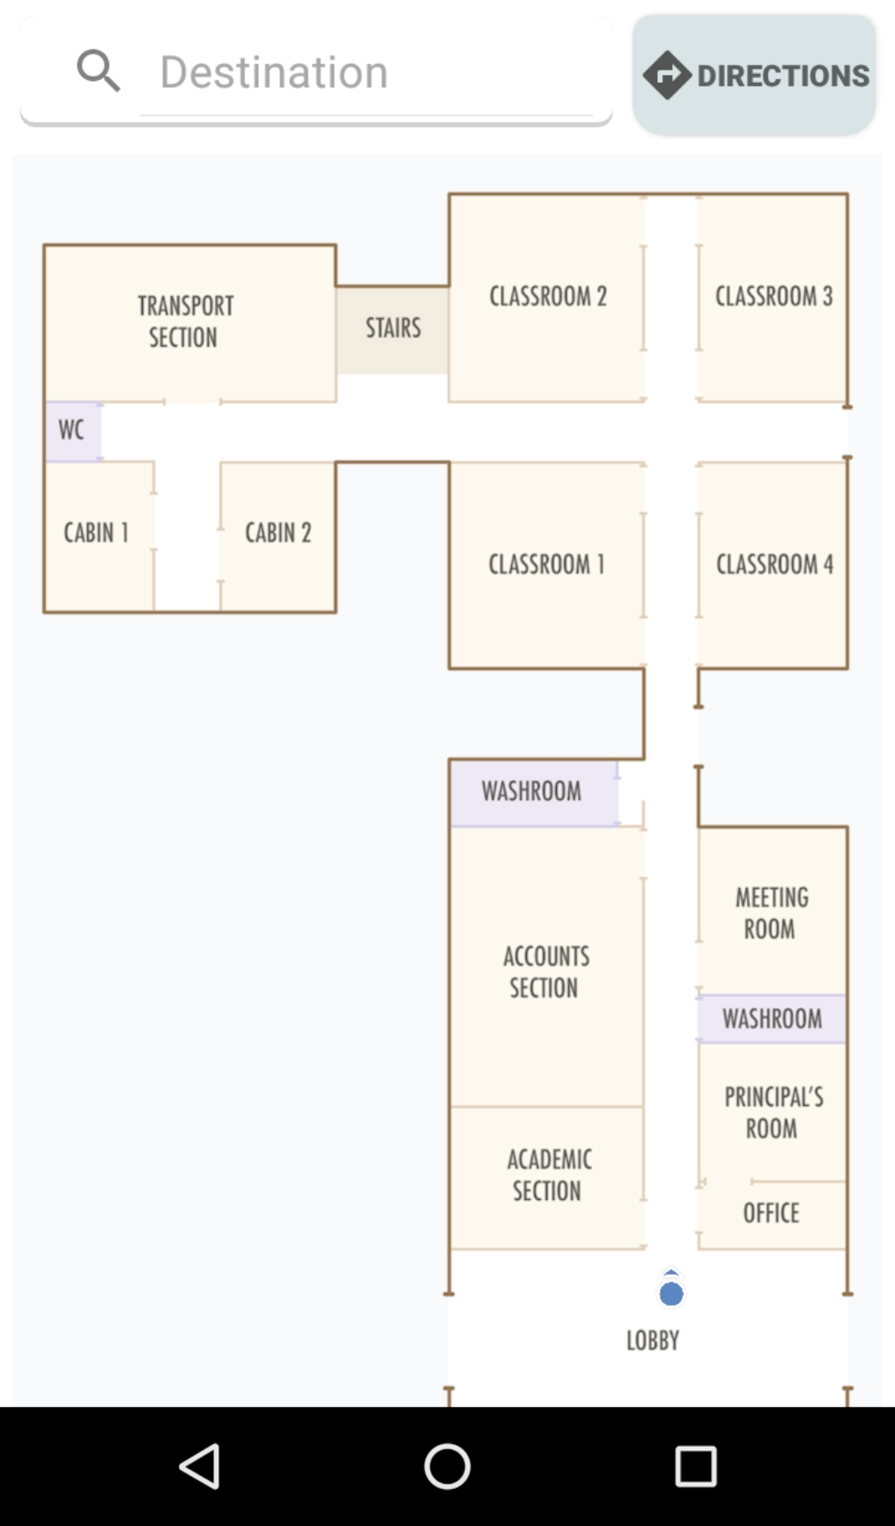
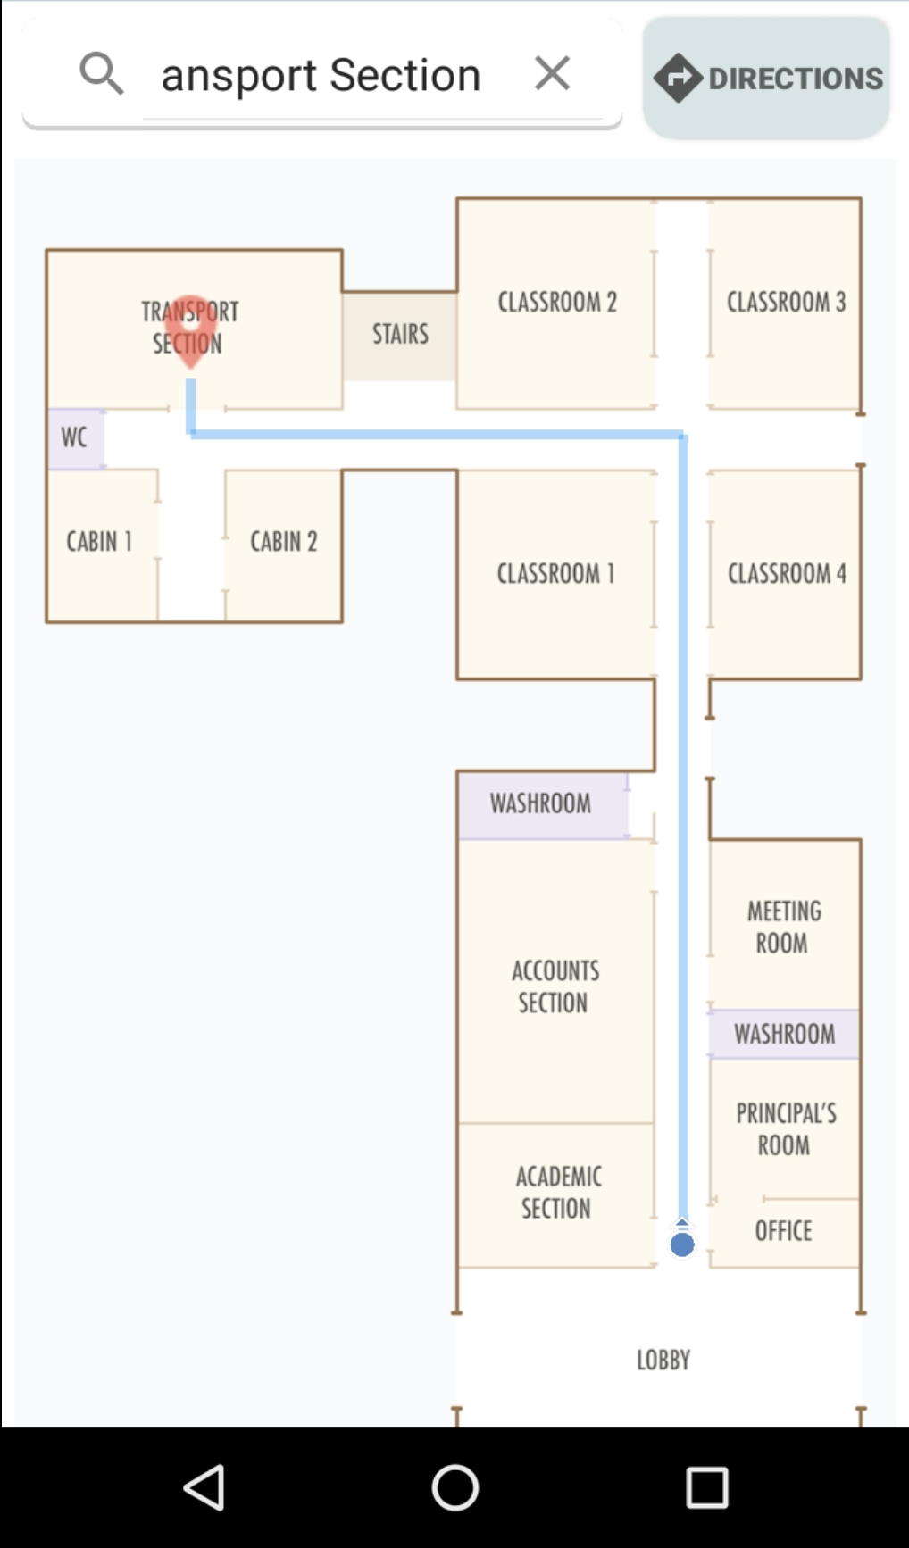
Android Application [Final Designs]
User selects starting position
User searches for destination

Slide 34
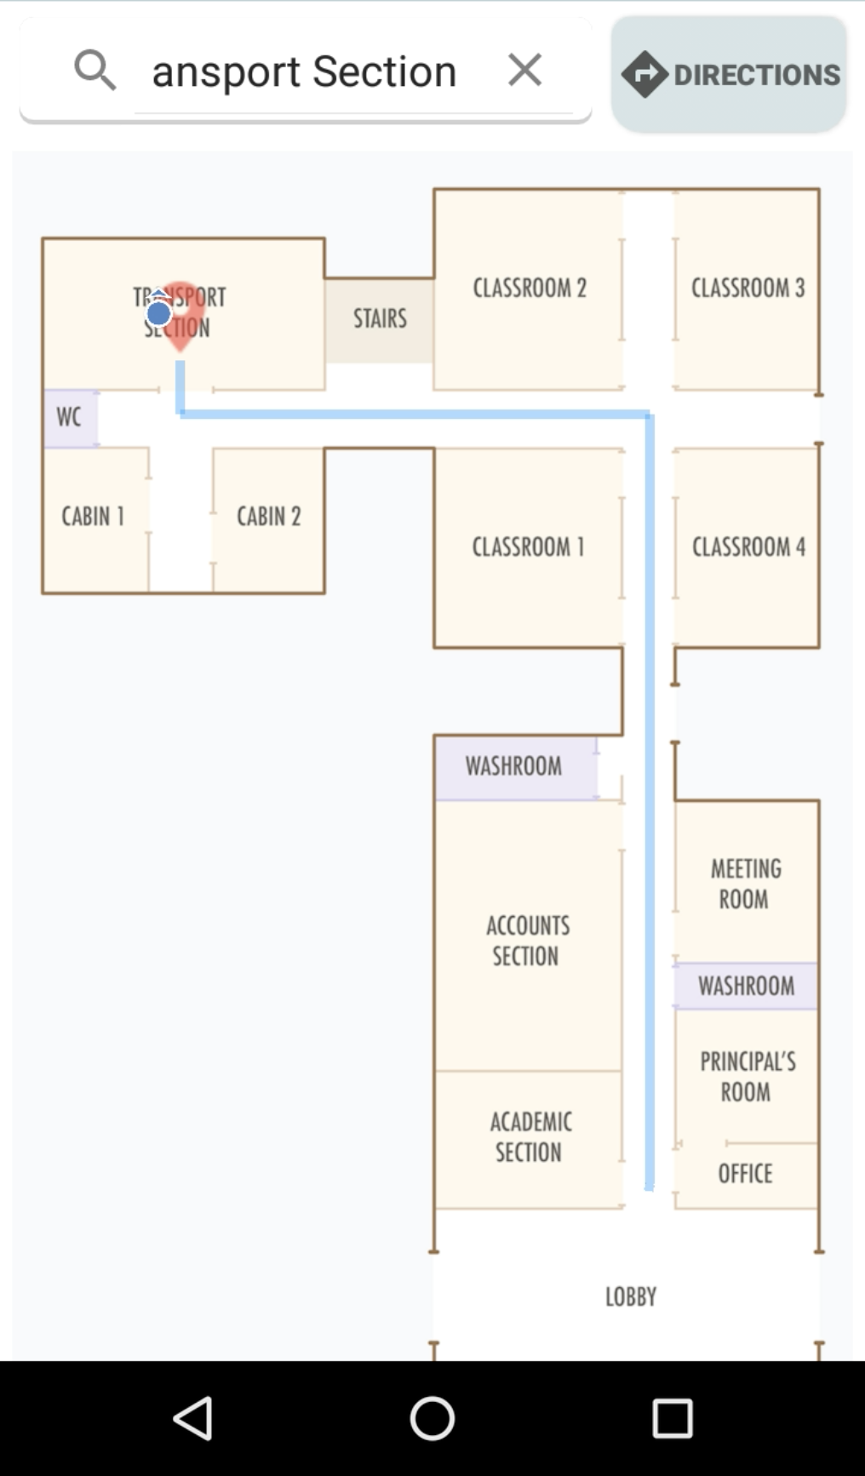
Android Application [Final Designs]
User walks towards destination
User reaches destination

Slide 35
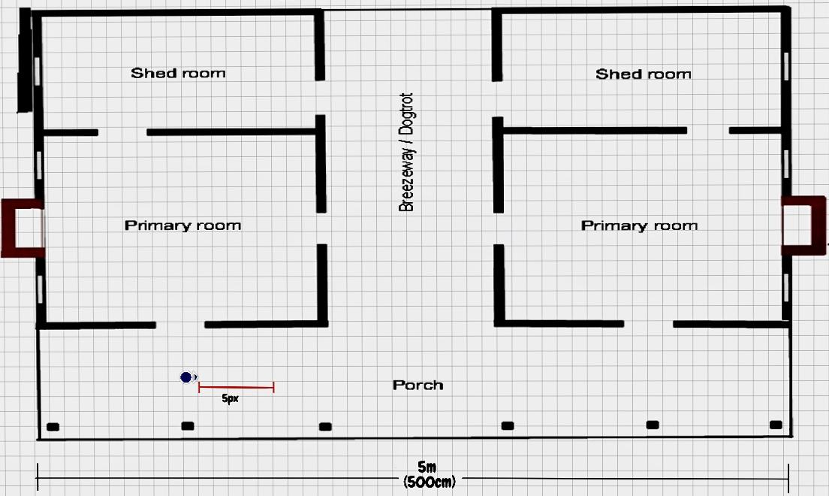
Mapping Example ( 1px = 10cm)
PixelsX= steplengthinCM * ratio of (imageX/realworldX)
PixelsY= steplengthinCM * ratio of (imageY/realworldY)

Slide 36
Computing Device Orientation
By computing a device's orientation, you can monitor the position of the device relative to the earth's frame of reference (specifically, the magnetic north pole).
The system computes the orientation angles by using a device's geomagnetic field sensor in combination with the device's accelerometer. Using these two hardware sensors, the system provides data for the following three orientation angles:
Azimuth (degrees of rotation about the -z axis) : This is the angle between the device's current compass direction and magnetic north.
Pitch (degrees of rotation about the x axis) :This is the angle between a plane parallel to the device's screen and a plane parallel to the ground
Roll (degrees of rotation about the y axis). This is the angle between a plane perpendicular to the device's screen and a plane perpendicular to the ground

Slide 37
Updating Device Position
Let (x , y) be the current position of the device.
Θ (Azimuth) is the angle between the device's current compass direction and magnetic north.
x = x + estimatedDistance * cos(θ);
y = y + estimatedDistance * sin(θ);

Slide 38
Navigation
We consider the map to consist of nodes and edges where the nodes refer to any location on the map and the edges refer to the path between them.
We start from the source and we use BFS to traverse the nodes until we reach the destination.
How is shortest path calculated?
The idea is to use a modified version of Breadth First Search in which we keep storing the predecessor of a given node while doing the search till we reach the destination.
And the shortest path is the shortest no. of hops required to reach the destination.

Slide 39
GEC Main Building Map
Node Graph

Slide 40
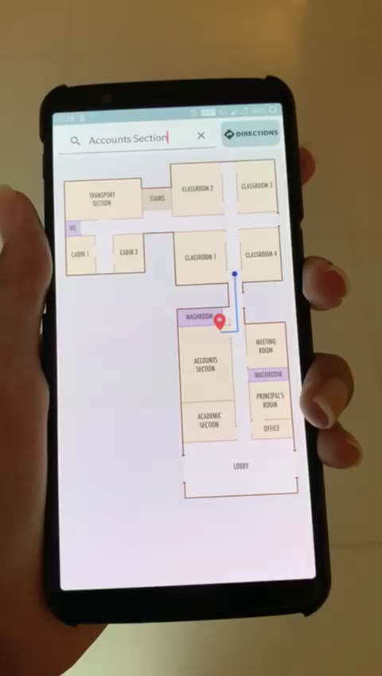
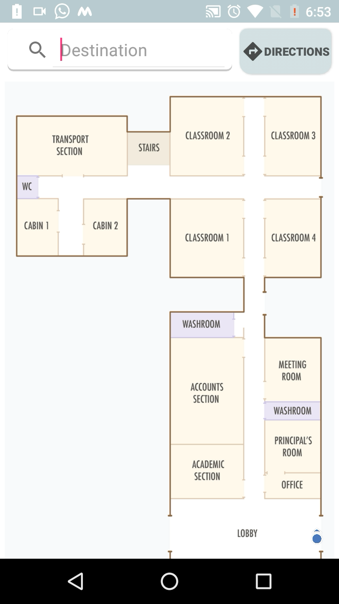
Demonstration

Slide 41
TESTING & RESULTS

Slide 42
Optimal Frequency & Sample Size
Remarks
Frequency and Sample Size were key parameters for the delay.
Increasing the sample size over 200 decreases the accuracy (more noise).
Decreasing it below 100 will also decrease the accuracy (less data available).
 | Sample Size | Frequency (Hz) | Delay (s)
1 | 200 | 10 | 20
2 | 100 | 10 | 10
3 | 200 | 50 | 4
4 | 100 | 50 | 3
5 | 200 | 100 | 2

Slide 43
Optimal Step Length Pixel Values
SS = 58.4cm, NS = 64.8cm , LS = 73cm.
Map Room x = 658cm (178px), Map Room y = 926cm (250px).
Key Observations :
Due to 2 second delay, the initial movement of the Blue Dot takes place after 3 steps.
Following movements are after 2 steps.
SS = 16px, NS = 18px, LS = 20px.

Slide 44
Optimal Frequency & Sample Size
Path | No. of Consistent | No. of Inconsistent | Consistency (%) | Average Error (Consistent) | Average Error (Inconsistent)
1 | 7 | 3 | 70% | 13.365 | 23.67
2 | 6 | 4 | 60% | 14.11 | 21.635
3 | 8 | 2 | 80% | 13.96 | 21.64
4 | 6 | 4 | 60% | 16.33 | 22.13
5 | 5 | 5 | 50% | 18.26 | 24.82
6 | 7 | 3 | 70% | 12.22 | 21.71
7 | 7 | 3 | 70% | 13.14 | 20.94
8 | 6 | 4 | 60% | 14.82 | 23.654
9 | 9 | 1 | 90% | 8.45 | 21
10 | 7 | 3 | 70% | 12.435 | 21.39
AVG | 6.8 | 3.2 | 68% | 13.71 | 22.26

Slide 45
Conclusion
We have managed to implement all 5 modules.
For the 2nd LSTM, we were not able to collect better data, hence we had to make do with the data we had collected by optimizing it.
We made use of the GEC Main Building map as the GUI of our application,
We got a good final accuracy of 15(±3)cm if the user holds the phone according to the way the data was collected.
If they don’t, the accuracy is 30(±10)cm.
Additionally to the 5 original modules, we also implemented the application of Navigation.

Slide 46
Future Work
Improvements
Wall Detection
Smoother Blue Dot movement
Better 2nd LSTM data
Node Database
Map Database
Multiple Floors
Abnormal Activities
Applications
Navigation in Malls, Hospitals, Office Campuses
Tracking
Security

Slide 47
THANK YOU

